Slide 1

HEART DISEASE PREDICTION
CHU DUC CHINH
INSTRUCTOR: NGUYEN THANH TUAN

Slide 2

PROBLEM DEFINITION
Heart Disease is the number 1 cause of death globally, taking an estimated 17.9 million lives each year.
90% of Heart Disease is preventable

Slide 3
INDEX
1
2
3
4
EXPLORATORY DATA ANALYSIS
DATA PRE-PROCESSING
BUILD AND TRAIN MODEL
MODEL OPTIMIZATION & EVALUATION

Slide 4
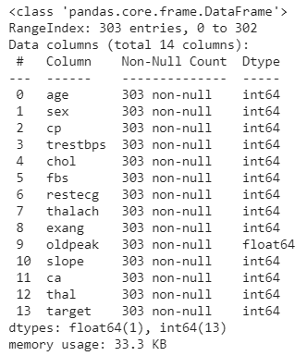
1. EXPLORATORY DATA ANALYSIS
DATA INFORMATION
What kind of data do we have?
What's missing from the data

Slide 5
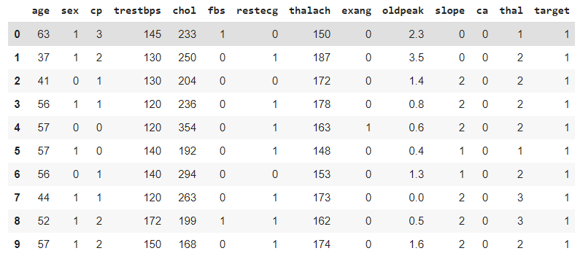
1. EXPLORATORY DATA ANALYSIS
DATA INFORMATION
What kind of data do we have?
What's missing from the data

Slide 6
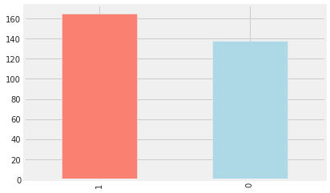
1. EXPLORATORY DATA ANALYSIS
DATA INFORMATION
What kind of data do we have?
What's missing from the data

Slide 7
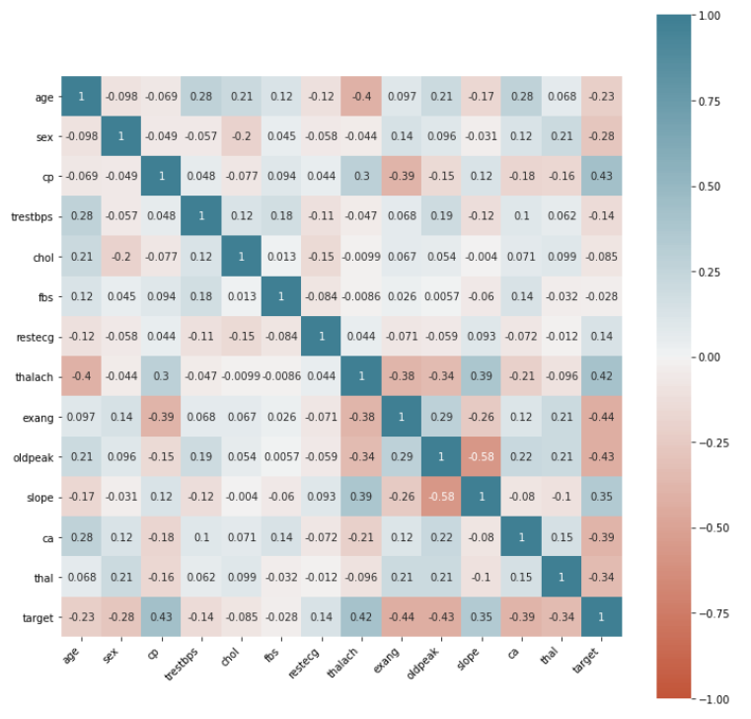
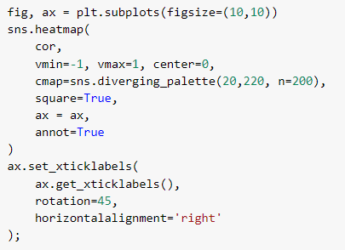
1. EXPLORATORY DATA ANALYSIS
Correlation Matrix

Slide 8
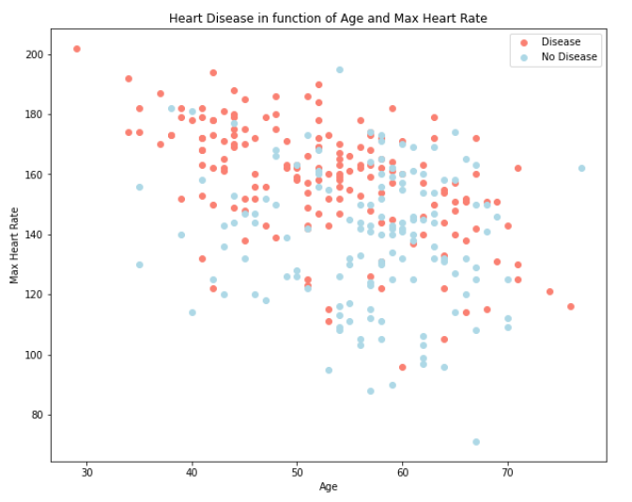
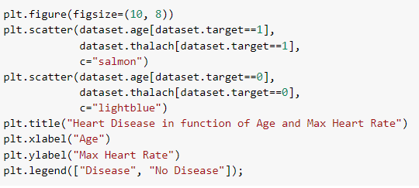
1. EXPLORATORY DATA ANALYSIS
Age vs. Max Heart Rate for Heart Disease

Slide 9
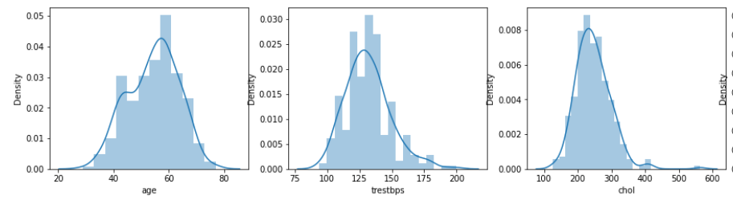
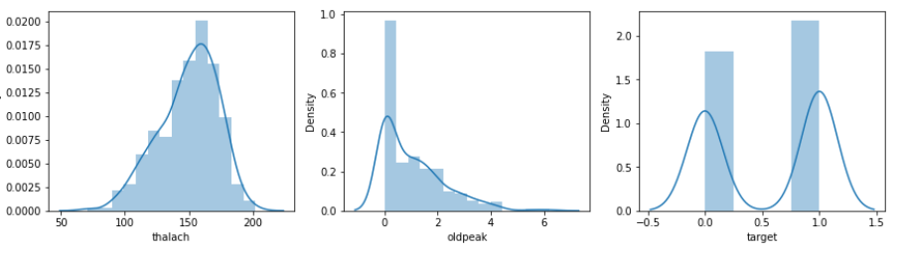
1. EXPLORATORY DATA ANALYSIS
Distribution

Slide 10

2. DATA PRE-PROCESSING
01
Extract Independent and Target Variables
02
Split the Data into Train and Test set

Slide 11

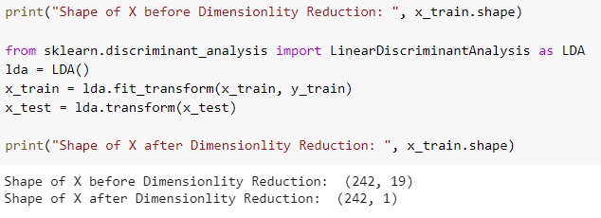
2. DATA PRE-PROCESSING
03
Feature Scaling
04
Dimensionality Reduction

Slide 12


3. BUILD AND TRAIN MODEL
01
SVM, Kernel = 'linear'
02
SVM, Kernel = 'rbf'

Slide 13
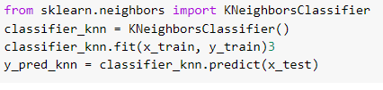

3. BUILD AND TRAIN MODEL
03
KNeighborsClassifier
04
DecisionTree

Slide 14
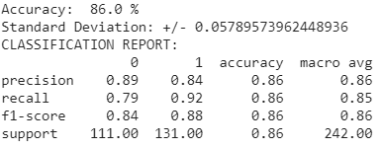
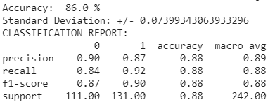
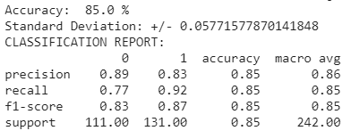

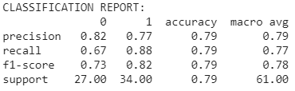
3. BUILD AND TRAIN MODEL
K-FOLD CROSS VALIDATION
01
03
KNeighborsClassifier
SVM, Kernel = 'linear'
02
04
DecisionTree
SVM, Kernel = 'rbf'

Slide 15
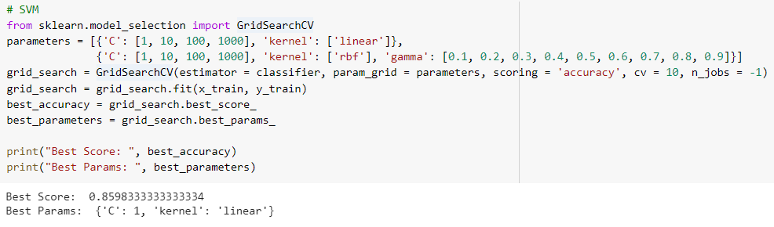
4. MODEL OPTIMIZATION USING GRID SEARCH
TECHNIQUE & MODEL EVALUATION

Slide 16
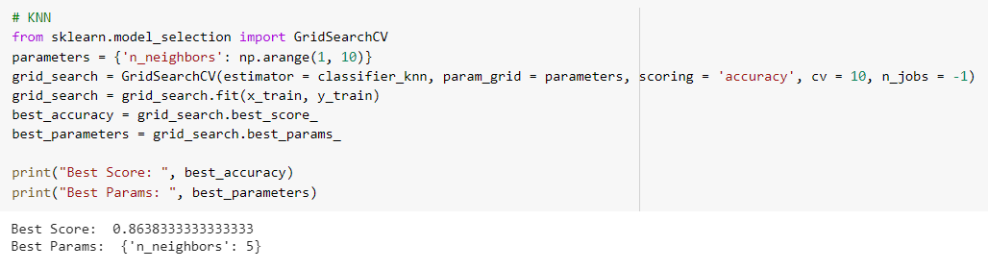
4. MODEL OPTIMIZATION USING GRID SEARCH
TECHNIQUE & MODEL EVALUATION

Slide 17
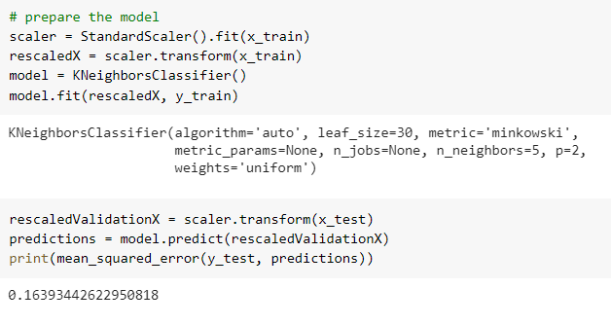

4. MODEL OPTIMIZATION USING GRID SEARCH
TECHNIQUE & MODEL EVALUATION

Slide 18
THANK YOU

